Slide 1
ECS736P Information Retrieval
Assignment 3: Search Engine Implementation
Topic: Lyrics Search Engine Design
Group 8
Members: Abu Zafar, Andreas Skiadas, Aparna George, Mahir Asif

Slide 2
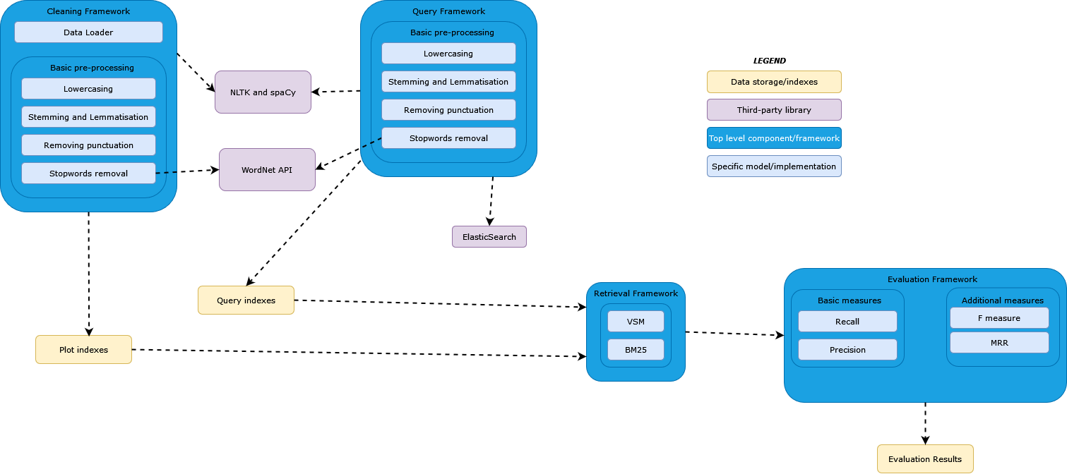
Architecture Diagram

Slide 3
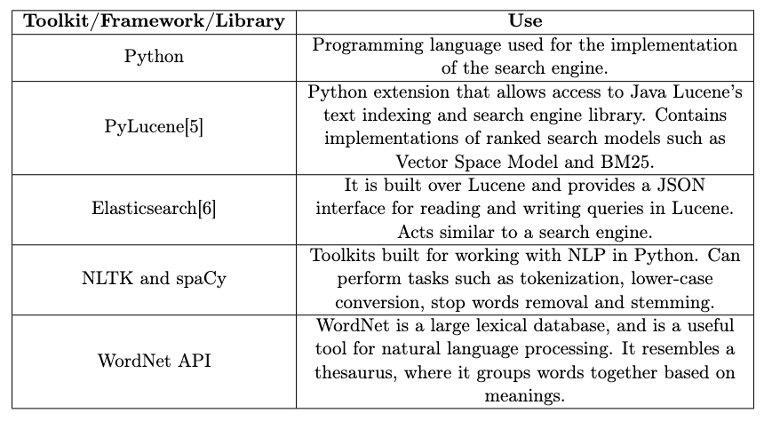

Slide 4
Dataset
Lyrics-data.csv
ALink - Link of song’s artist page
SName - Name of the song
SLink - Link of song’s lyrics page
Idiom - Language of the song
Artists-data.csv
Artist - Name of artist
Song - Number of artist’s songs
Popularity - Popularity score for artist
Link - Link to the artist’s page
Genre - Primary musical genre of the artist
Genres - List of genres artist fits into

Slide 5
Problem statement
Given an input user query, utilize information retrieval methodologies to accurately retrieve the relevant documents.
The dataset collection used contains song names, the song lyrics and artist names. The user queries will be made up of lyric segments.
Implement document indexing, ranking and retrieving models. Evaluate the quality of our implemented retrieval models.

Slide 6
Data cleaning
Select a subset of the dataset (using Pandas and Numpy):
Filter out non-English language songs from dataset
Select 1000 songs (reduces processing time)
Basic pre-processing (using NLTK and spaCy):
Lowercasing
Stemming and Lemmatisation
Removing punctuation
Stopword removal

Slide 7
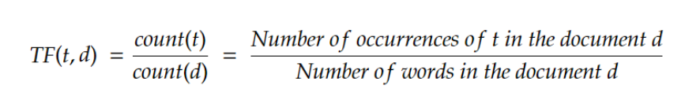

Indexing Framework
TF-IDF method used for document indexing.
Term frequency focuses on how many times a word occurs in a document.
IDF is the inverse of the frequency across the document collection.
Words that appear more frequently are ranked higher.

Slide 8
Query Processor Framework:
Every information retrieval system starts with a user query.
The query represents the users information need.
In this case, the lyric fragment is to be matched to a relevant song.
The query has to be pre-processed like the documents in order to compute a numeric representation that can be passed into the retrieval algorithm.
The more complex a query is, the more specific the document retrieved.
In some cases this can lead to no documents being retrieved.

Slide 9
Retrieval Framework
Vector space model:
The documents and queries are represented as a numerical dimensional vector produced by TF-IDF indexing.
The document collection is represented as a term-document matrix.
It uses a cosine similarity measure between the query vector and each document vector.
Documents are sorted by decreasing score of similarity (to display only the top results for the user).
Notes:
Vector Space Model
Simple model based on linear algebra
Term weights not binary
Allows computing a continuous degree of similarity between queries and documents
Allows ranking documents according to their possible relevance
Allows partial matching

Slide 10
Retrieval Framework
BM25:
It is an improvement on TF-IDF VSM, where we keep the same TF*IDF formula but add other parameters to refine our retrieval model.
One parameter stops term frequency saturation.
Another parameter can be used to reduce the impact of document length.
BM25 allows us to tune the retrieval model for the specific collection.
Notes:
Vector Space Model
Simple model based on linear algebra
Term weights not binary
Allows computing a continuous degree of similarity between queries and documents
Allows ranking documents according to their possible relevance
Allows partial matching

Slide 11
Evaluation Framework
The search results were evaluated using multiple metrics:
Precision: number of relevant retrieved documents over the number of documents retrieved.
Recall: number of relevant retrieved documents over the number of relevant documents.
F1 score: (Harmonic Mean of Precision and Recall) .
MRR (Mean Reciprocal Rank@K - a metric which considers only the position of the first relevant document returned in the first K documents for each query).
The top 20 results from the Okapi BM25 model was used to establish our ground truth for the queries.

Slide 12
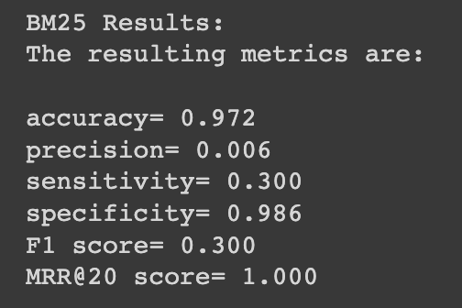
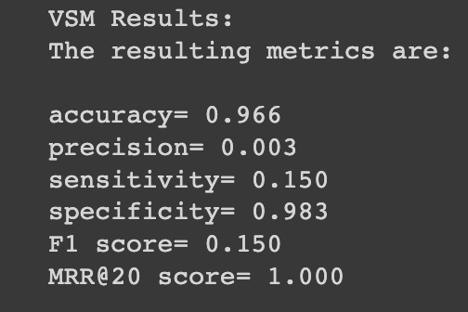
Demonstration

Slide 13
Who in the group did what
Abu (25%) - Load and pre-process the dataset, Standard BM25 implementation, Implement indexing framework and VSM model
Andreas (25%) - Load and pre-process the dataset, Standard BM25 implementation, Implement indexing framework and VSM model
Mahir (25%) - Implement evaluation framework, BM25 model, Elastic Search framework, user interface, query processing framework
Aparna (25%) - Implement evaluation framework, BM25 model, Elastic Search framework, user interface, query processing framework

Slide 14
Thanks for watching!

